Slide 1
Lesson 4: Time Management and using GTD
Dr Fadi Safieddine
1
Dr. Fadi Safieddine copyright 2021

Slide 2
Lecture Content
What is time management?
What happens when time management starts getting stressed.
What happens when time management fails!
Getting things done: Credit to the author.
Key principles
Five steps process.
Date related tasks.
Other resources.
>> Finally, reminder of Task 2!
2

Slide 3
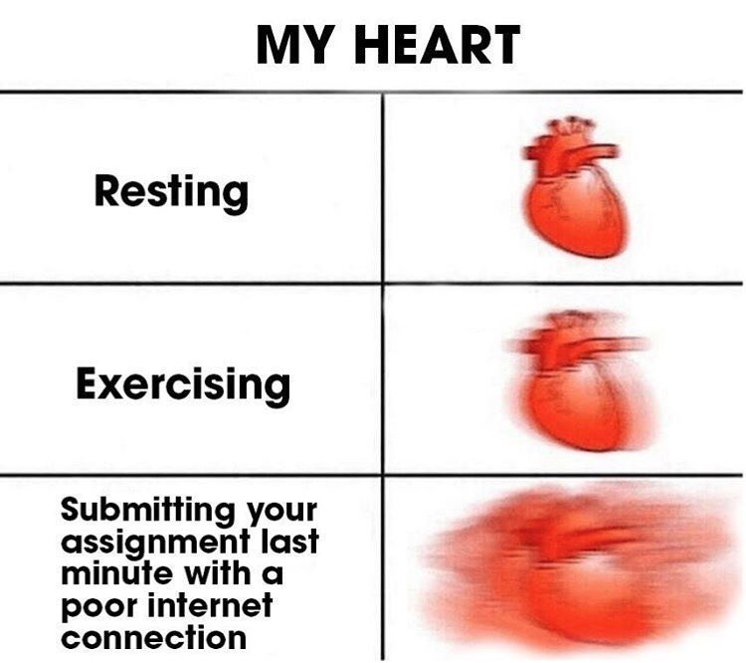
YOUR HEART
Notes:
Is this you? Is this how you like to work?

Slide 4
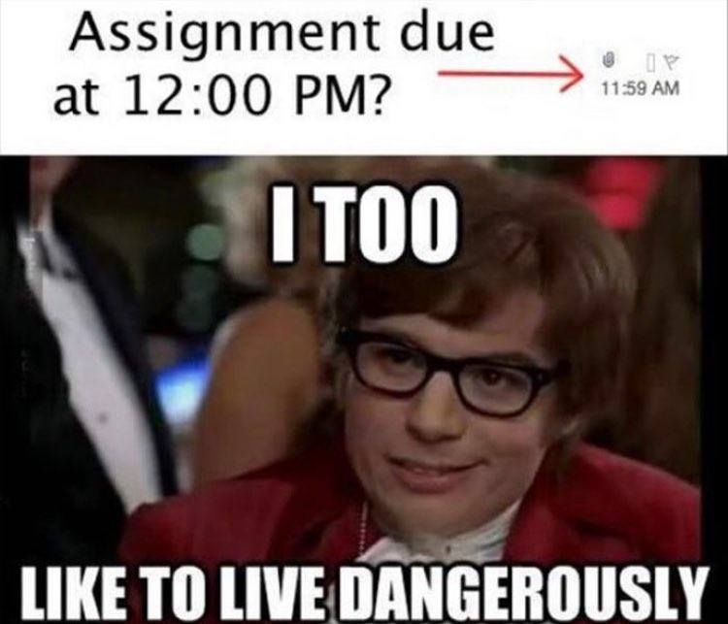
Notes:
Is this you? Is this how you like to work?

Slide 5
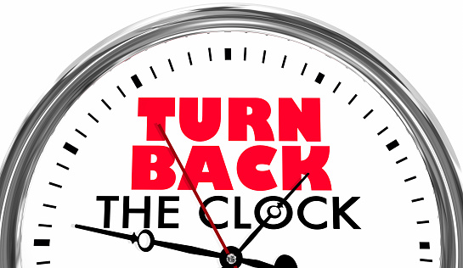
Notes:
Imagine if the deadline was the day before at 12:00 mid day, would you have started the assignment earlier? Would you have stayed up late two night before?

Slide 6
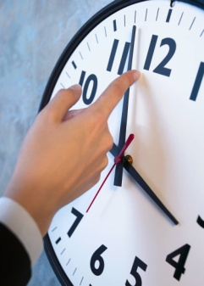
What is time management?
“Time management is the act or process of planning and exercising conscious control over the amount of time spent on specific activities, especially to increase effectiveness, efficiency, or productivity.” (Time Management, Wikipedia, 2013)
We can use variety of skills, tools, and techniques to manage our time.
Time management is usually considered in relation to work tasks but for many this goes beyond to personal time management.
6
Notes:
Source: http://en.wikipedia.org/wiki/Time_management

Slide 7
Time Management:
Our first practice:
We are constantly bombarded with tasks and deadline: Work related, study related, family related, and personal related:
Take the next 10 mins to write down tasks that you have to complete urgently.
Take another 10 mins to add tasks you think are important but not urgent.
Take another 10 mins to add tasks not important, not urgent, but you wish to complete if you had more time.
7
Notes:
Please take this practice seriously otherwise you will not benefit from this lesson as much as you think!

Slide 8
End of Part 1
Activity 4.1. Complete the 30 mins activity of reflecting on the following questions:
Take the next 10 mins to write down tasks that you have to complete urgently.
Take another 10 mins to add tasks you think are important but not urgent.
Take another 10 mins to add tasks not important, not urgent, but you wish to complete if you had more time.

Slide 9
Time Management:
Part 2
9

Slide 10
Time Management:
Now imagine if all these tasks were done, on time, and are complete.
Will there be hobbies, fun activities, sports or other tasks you want to pursue?
YOU CAN but lets analyse your list for few minutes.
Does it include subject (module) deadlines and to do lists?
Does it include family and friends tasks, and things you want or want to do?
Does it include personal tasks and things you wish you could do?
What is more important?
10

Slide 11
Time Management:
What is more important?
If you said single category of these is more important, you are wrong.
To be productive is to be happy
to be happy you need to get a balance
to get a balance is to work with less stress
to be on top of what is going on you need to feel like everything is taken care off.
From this the book by David Allen: ‘Getting things done: The act of stress free productivity’
11

Slide 12
What happens when your time management gets stressed?
You start prioritising.
You find yourself not sure what to do next.
You start thinking more about how you can do all the work rather than do anything about it.
(Work, family and personal) Tasks start accumulating and you turn into ‘Fire Fighting mood’.
12

Slide 13
What happens when your time management gets stressed?
What is the problem with “Fire Fighting”?
Fight the problems as they appear, always running around trying to meet deadlines.
Tasks are done because they have to be done rather than you are ready to do them.
Poor standard start taking hold.
Tasks which may have been less important become very important.
You are stressed all the time, unhappy and tend to choose your priority: Work, Family, or Personal.
Work for the work-alcoholic or who worry about money.
Family for those who feel guilty.
Personal for those who are by nature self centred.
None of these options is necessary good as sooner or later you --- CRASH ---
13

Slide 14
CRASH!!
Possible symptoms of a crash.
Complete HALT!
Disconnection with other students or staff.
Hanging around people who are in the similar situation (morn together or not take it seriously).
Blaming the process: “It is impossible!” – even though others are managing.
Blaming others: “It is not my fault!”
Self blaming: “It is all my fault!”
Waiting for the ship to sink and see what happens!
14

Slide 15
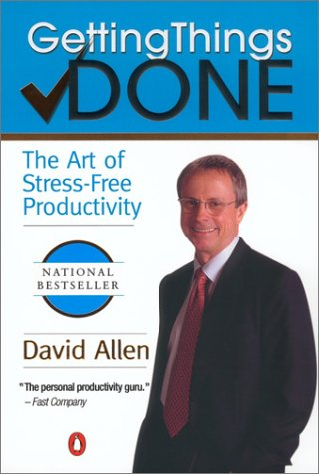
David Allen’s book:
Getting Things Done:
The art of Stress free productivity – recommended book to read – why?
Time management is the source of problems for most people.
Managing university commitments, work commitments, family commitments, and personal commitments.
Get this right and you will find you are able to manage yourself much better.
His method is tried and tested by many including myself!!
15

Slide 16
Key principles of the book:
When you are not in control much of your energy is wasted trying to be in control rather than doing anything to reduce the pressure.
Source of stress is lack of control. What we cannot control gives us the most stress.
Which of these cases will give most stress:
Getting stuck in car traffic jam when you have an important interview to attend very soon.
Getting stuck on a plane when you have an important interview to attend very soon.
Getting to the interview on time but failing it because you did not answer the questions correctly?
16
Notes:
Students will likely to list these as 2 very stressful, 1, stressful, 3 less stressful.

Slide 17
End of Part 2
Activity 4.2. Rank your stress levels in the order of stressful:
Getting stuck in car traffic jam when you have an important interview to attend very soon.
Getting stuck on a plane when you have an important interview to attend after you land, but the plane is running late.
Getting to the interview on time but failing it because you did not answer the questions correctly?

Slide 18
Key principles of the book:
Part 3
18
Notes:
Students will likely to list these as 2 least control, 1, little control, 3 some control.

Slide 19
Key principles of the book:
Are you able to find an association between Control and Stress.
Getting stuck in car traffic jam when you have an important interview to attend very soon.
Control lost….Stress is 10/10
Getting stuck on a plane when you have an important interview to attend very soon.
Limited control….Stress 8/10
Getting to the interview on time but failing it because you did not answer the questions right?
Nothing you can do about it now…1/10
19
Notes:
Students will likely to list these as 2 least control, 1, little control, 3 some control.

Slide 20
Key principles of the book:
To reduce stress, you need to be in control:
You need to have a system that allows you to control your time.
Achieve what you want.
Incomplete or tasks that never finish reduce your attention and your control.
Identify things that ‘take away from your attention’ and put them in control.
David Allen calls them “Ring your bell.”
We need to organize reminders and tasks so we can free our brain from keeping track of everything.
20

Slide 21
GTD: How it works:
The first time you do it you need to:
Collect
Process
Organize
Review
Do
21

Slide 22
GTD Step 1: Collect
Identify everything that you need to track, remember, or act upon in what Allen calls a 'bucket‘.
This would be similar to any of the old ‘to do list’ you did in the past.
However, this has to cover everything in your life: Work, Family, and Personal.
Take your time and make sure there is absolutely nothing left on your mind.
Ideally do the list on a device: (Excel sheet, Word or other).
22

Slide 23
GTD Step 1: Collect
Pull everything off your desk, your “to do lists”, and diaries and put them in this bucket.
Don’t deal with anything until you have completed everything and thought of everything.
Then, go through the Bucket. Deal with each item as you touch it.
This is the next step: Process.
23

Slide 24
GTD Step 2: Process
Moving from top to down:
Deal with one entry at a time.
Identify tasks that require 2 minutes or less:
The two-minute rule:
The most important rule ever!!!
If it takes less than 2 mins do it.
Never leave it.
Having it on your mind is going to stress you and put pressure on other tasks.
Do not think about it, just do it.
24

Slide 25
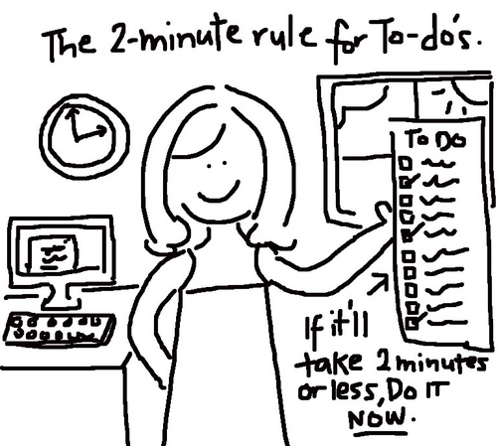
The Two minute Rule!
If you have a task that requires
less then 2 minutes – do it immediately.
Example:
Quick call.
Quick reply to an email.
Text message.
The more you get done using this rule, the more attention and time you have to focus on more involved tasks.
- I have my own take on this. I have the ‘less than 5 mins’ rule.
25

Slide 26
GTD Step 2: Process
Tasks requiring Delegate it,or Defer it.
If not
File it for reference
Throw it away, or
Assign a time when it would need to come back in action.
Tasks that do not fit any of these categories, these have to be assigned a time and place to do. We will talk about it in the next part.
26

Slide 27
End of part 3:
Activity 4.3: Doing the 2 minute rule to finish tasks that need little time is important for the following key reason (Tick as many relevant):
Help your mind focus on the bigger tasks later.
Means you never have to waste time thinking about them.
You achieve faster turn over of task.
Cannot be used to answer emails as emails take more than 2 mins.
Can be used for essay writing it you think it will take less than 2 mins.

Slide 28
GTD Step 2: Process
Part 4
28

Slide 29
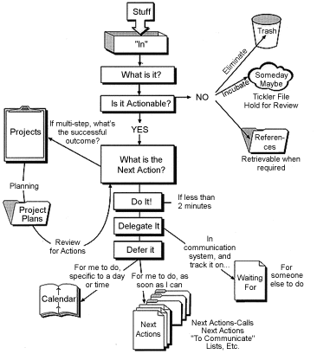
GTD Step 2: Process
29

Slide 30

GTD Step 3: Organise
Next actions – As actions appear, consider the time it will take. Less than 2 mins, do it immediately. Otherwise follow the steps in previous slide.
Projects – Put all the 'open loop' which requires more than one task to achieve together as one 'project’.
Waiting for – Items that you delegate but still need to follow up on. Give them a due date to follow up on them.
Someday/Maybe – indicate here tasks that you want to do at some point, but not right now.
30

Slide 31
GTD Step 3: Organise
Key advice here:
Always think of the next action.
Takes less than 10 seconds.
Always break things down into doable tasks:
If it looks too much, then you did not break it down enough.
Do not be negative, put a positive spin on tasks.
Self destructive thinking reduces your productivity.
Pinpoint the source of the problem. If it is stressing you:
You need to get control of it.
Or you need to declare it outside your control!
31

Slide 32
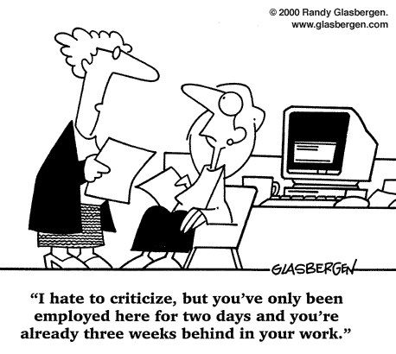
Pinpoint the source of the problem:

Slide 33
GTD Step 4: Review
Review your lists of actions and reminders once a day.
Make a 30 mins a week allocated to review all your outstanding actions, projects and 'waiting for' items.
If you feel your memory of “things to do” sometimes fails, then maybe you need to do these steps more often.
33

Slide 34
GTD Step 5: Do!!!
What to do first?
Context: Things the complement each other first.
Time: Things that take less time.
Energy: Things that take less energy.
Priority: By due date.
34

Slide 35
End of part 4:
Activity 4.4. Organise the GTD steps in the correct order:
Organize
Review
Collect
Process
Do

Slide 36
Date related tasks:
Part 5
36

Slide 37
Date related tasks:
You must have a calendar:
Electronic via your phone is desirable.
Checking it the night before and again that morning.
Move tasks that can only be done on that date not tasks that have their deadline on that date.
You should resist putting your ‘to do’ list and items that can be completed now on your calendar in order to create ‘free time now’ and false feeling of managing your time.
37

Slide 38
Date related tasks:
You need to treat your calendar as scared and only include tasks that are time related.
“Never leave for tomorrow that which you can do today"
Tasks that have deadlines should be put at dates that allow you enough time to do them.
Example: On 2nd of November reminder: Complete the first three tasks for the report which is due on 12th of November.
38

Slide 39

Additional support:
Tips and Tools
www.davidco.com
Getting Things Done Outlook Add-In
http://gtdsupport.netcentrics.com
GTD for Ipad/iphone: GTD
Look for “Getting things done” app.
GTD for Androids: DGT GTD
GTD for Blackberry
39

Slide 40
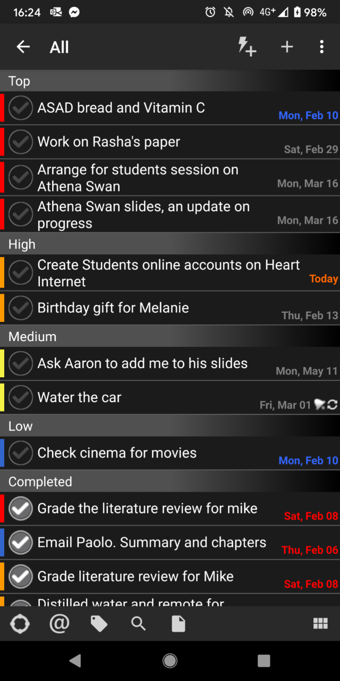
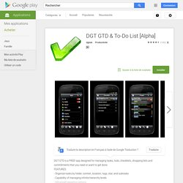
DGT GTD

Slide 41
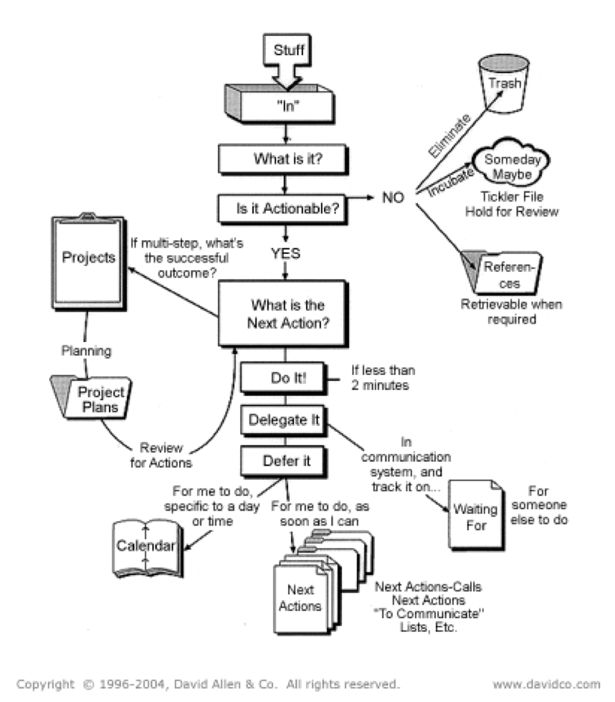
Task 2:
Task 2: Individual Time Management Plan; Due week 4, L.O. 1 & 5. 10% (Individual)
Students to create a comprehensive time management plan based on GTD. Students are allowed to use a different approach, provided it is an academically published approach, and they provide a citation of their source.
The key aspect of this assessment is that the student has demonstrated good forward planning that covers academic tasks and deadlines, personal development deadlines, and day to day deadlines.
This topic is covered in lesson 4 and due the same week.

Slide 42
End of part 5
Activity 4.5. Complete following adaptation of the GTD approach:
Allocate an hour to write everything you have on your mind into the bucket of things (including personal wish list).
Sort the 2 or 5 mins activities first and clear them all up.
Sort the remaining into a GTD app of your choice.
For one week, stick to the plan to test if it works.
Make a screenshot of your app – and Task 2 of your assignment (10%) is completed!

Slide 43
Reflection

